Slide 1
TRIGONOMETRIC EQUATIONS

Slide 2
DEFINITION: TRIGONOMETRIC EQUATIONS
Equations that involve the trigonometric functions are called trigonometric equations.
Solving a trigonometric equation means the same thing as solving an algebraic equation, like finding the values of the variable that satisfy the equation. To solve trigonometric equation, we use the same techniques used in algebraic equations such as isolating the variable, collecting like terms and factoring. In addition to these techniques, we can also simplify the equation by substituting trigonometric identities.

Slide 3
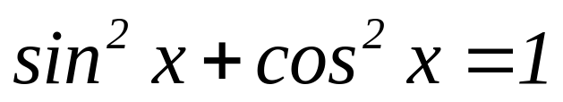
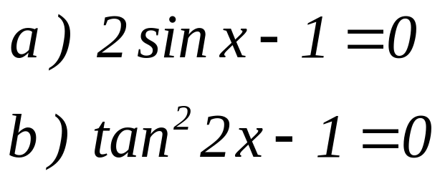
TWO TYPES OF TRIGONOMETRIC EQUATIONS:
Identical Trigonometric Equation
A trigonometric equation that is true for all permissible values of the unknown variable for which the equation is defined.
Example:
Conditional Trigonometric Equation
A trigonometric equation that is true for some , but not all, permissible values of the unknown variable.
Example:

Slide 4
GUIDELINES IN SOLVING TRIGONOMETRIC EQUATIONS
If the equation contains one function of a single angle, use algebraic technique to solve for the angle.
Solve a quadratic equation containing a single function of the same angle by factoring. Otherwise, use quadratic formula.
If the equation contains several functions of the same angle, substitute trigonometric identities to obtain a single function.
If the equation contains several angles, substitute trigonometric identities to obtain a function of a single angle.

Slide 5











EXAMPLE:
Find the exact solutions to each equation for the interval .
II. Find the exact solutions to each equation for the interval .
Notes:
plane

Slide 6



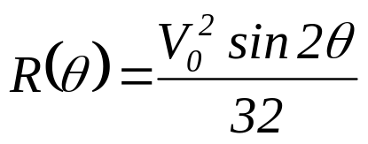

Application:
If a projectile is fired with velocity V₀ at an angle ,then its range, the horizontal distance it travels (in feet ), is modeled by the function . If V₀ =2200 ft/sec, what angle (in degrees) should be chosen for the projectile to hit a target on the ground 5000 feet away?
Notes:
plane

